Slide 1

RETAIL STORE STOCK INVENTORY ANALYTICS
Team ID:PNT2022TMID27973
PROJECT DESCRIPTION:
This dataset contains a lot of historical sales data of a Brazilian top retailer. Basic Questions of every retailer: How much inventory should I carry? Too much inventory means working capital costs, operational costs and a complex operation, lack of inventory leads to lost sales, unhappy customers and a damaged brand. This is why short-term forecasting is so important in the retail and consumer goods industry.
Technical Architecture:

Slide 2
DATA COLLECTION AND PREPARATION

Slide 3
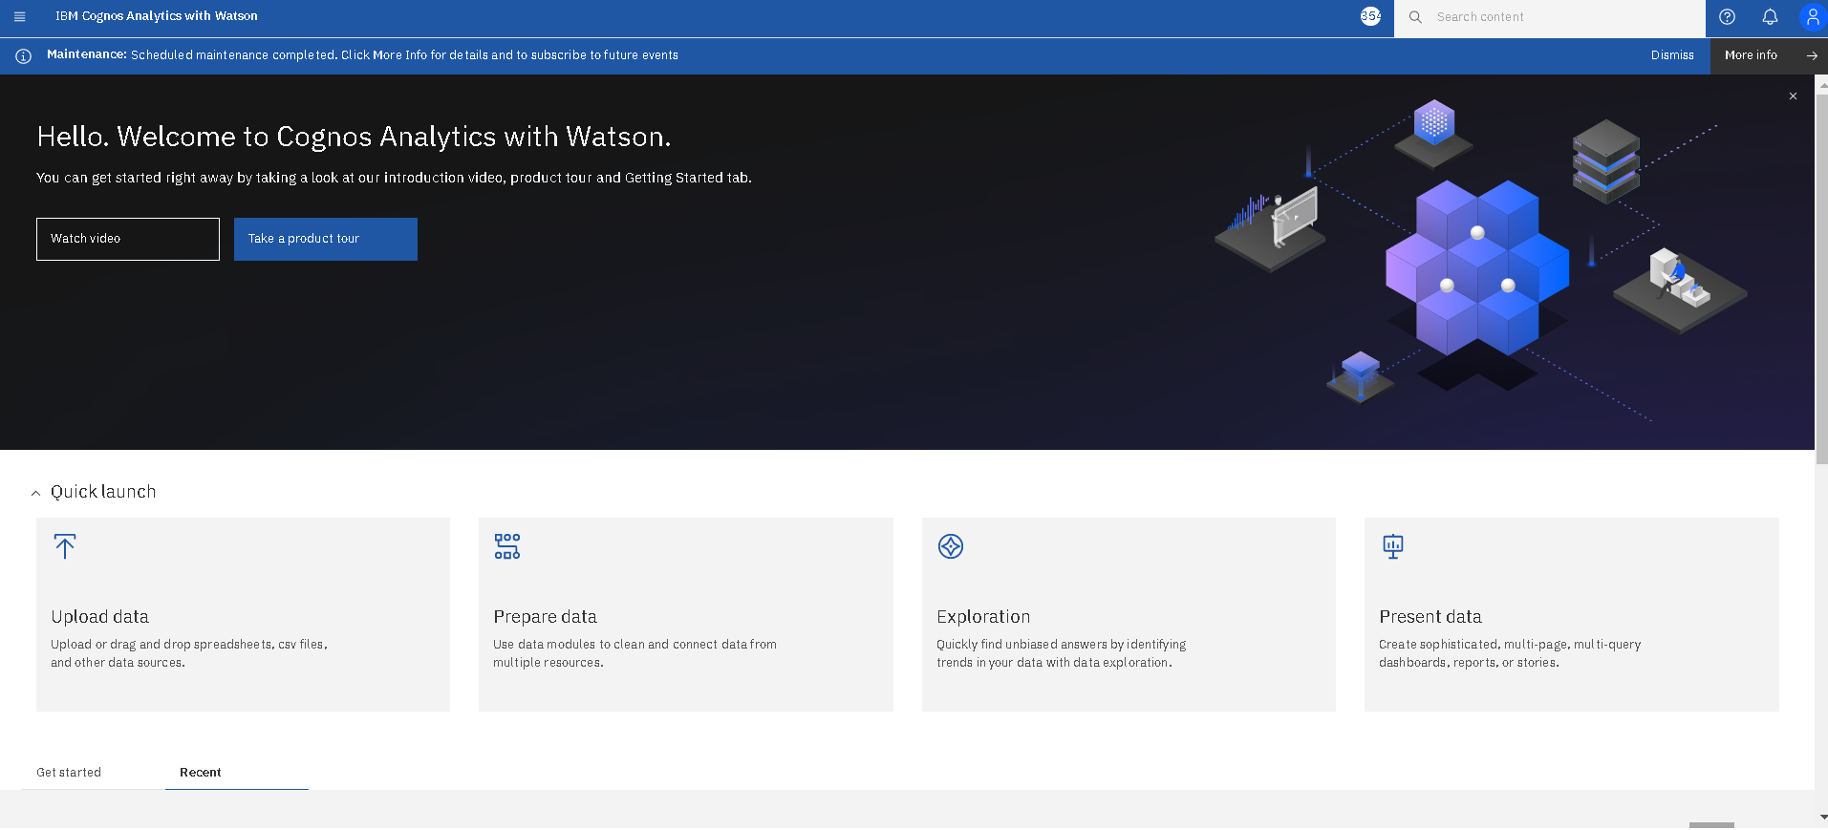

Slide 4
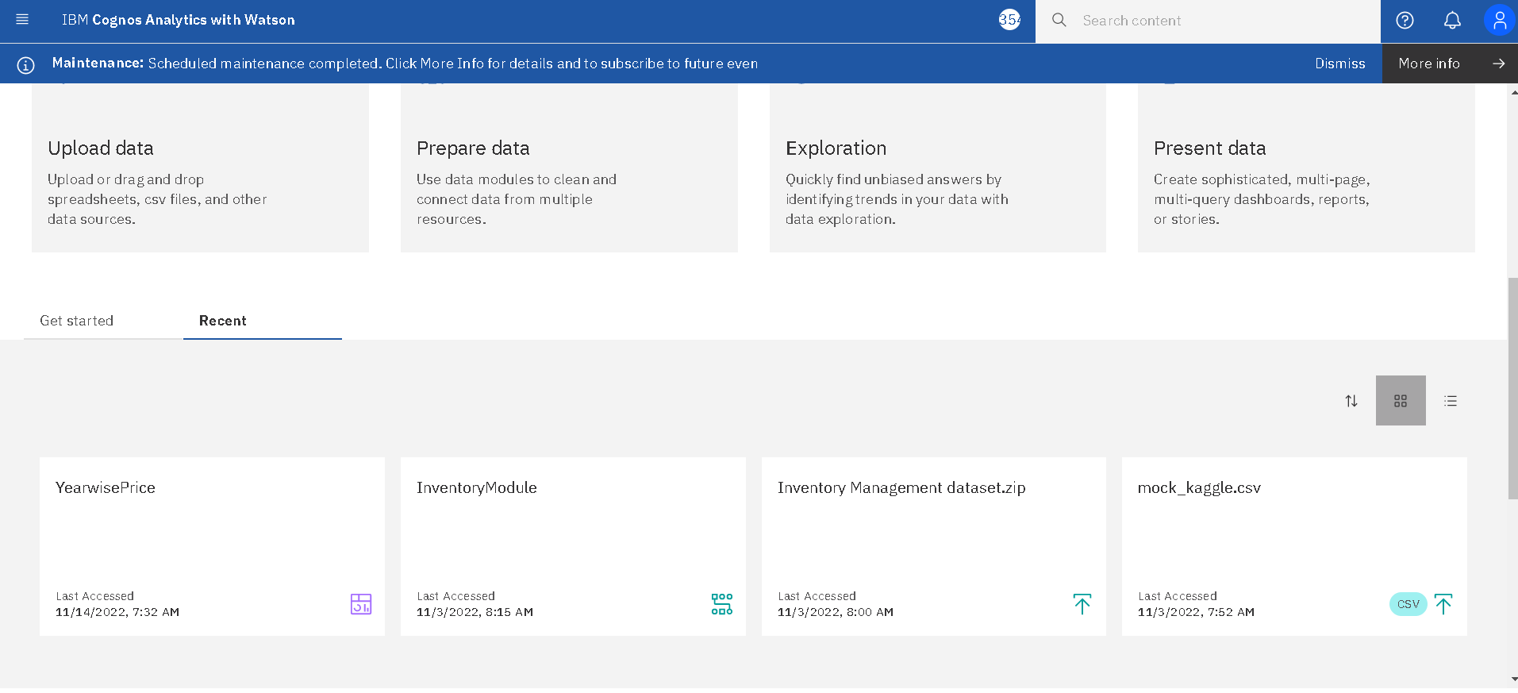

Slide 5
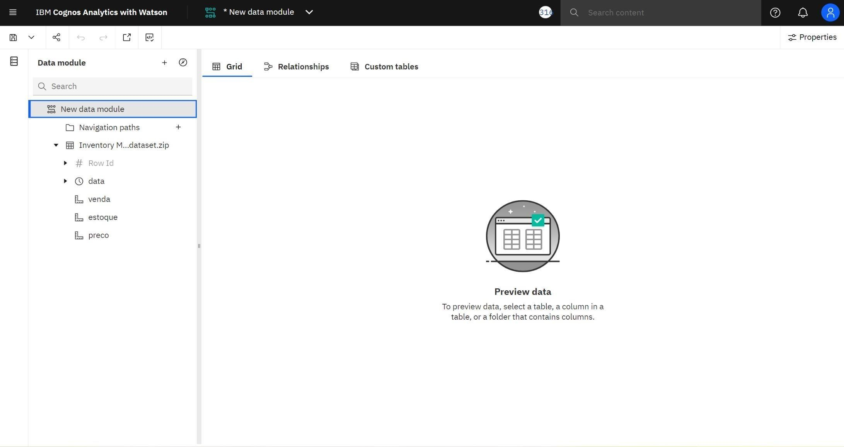

Slide 6
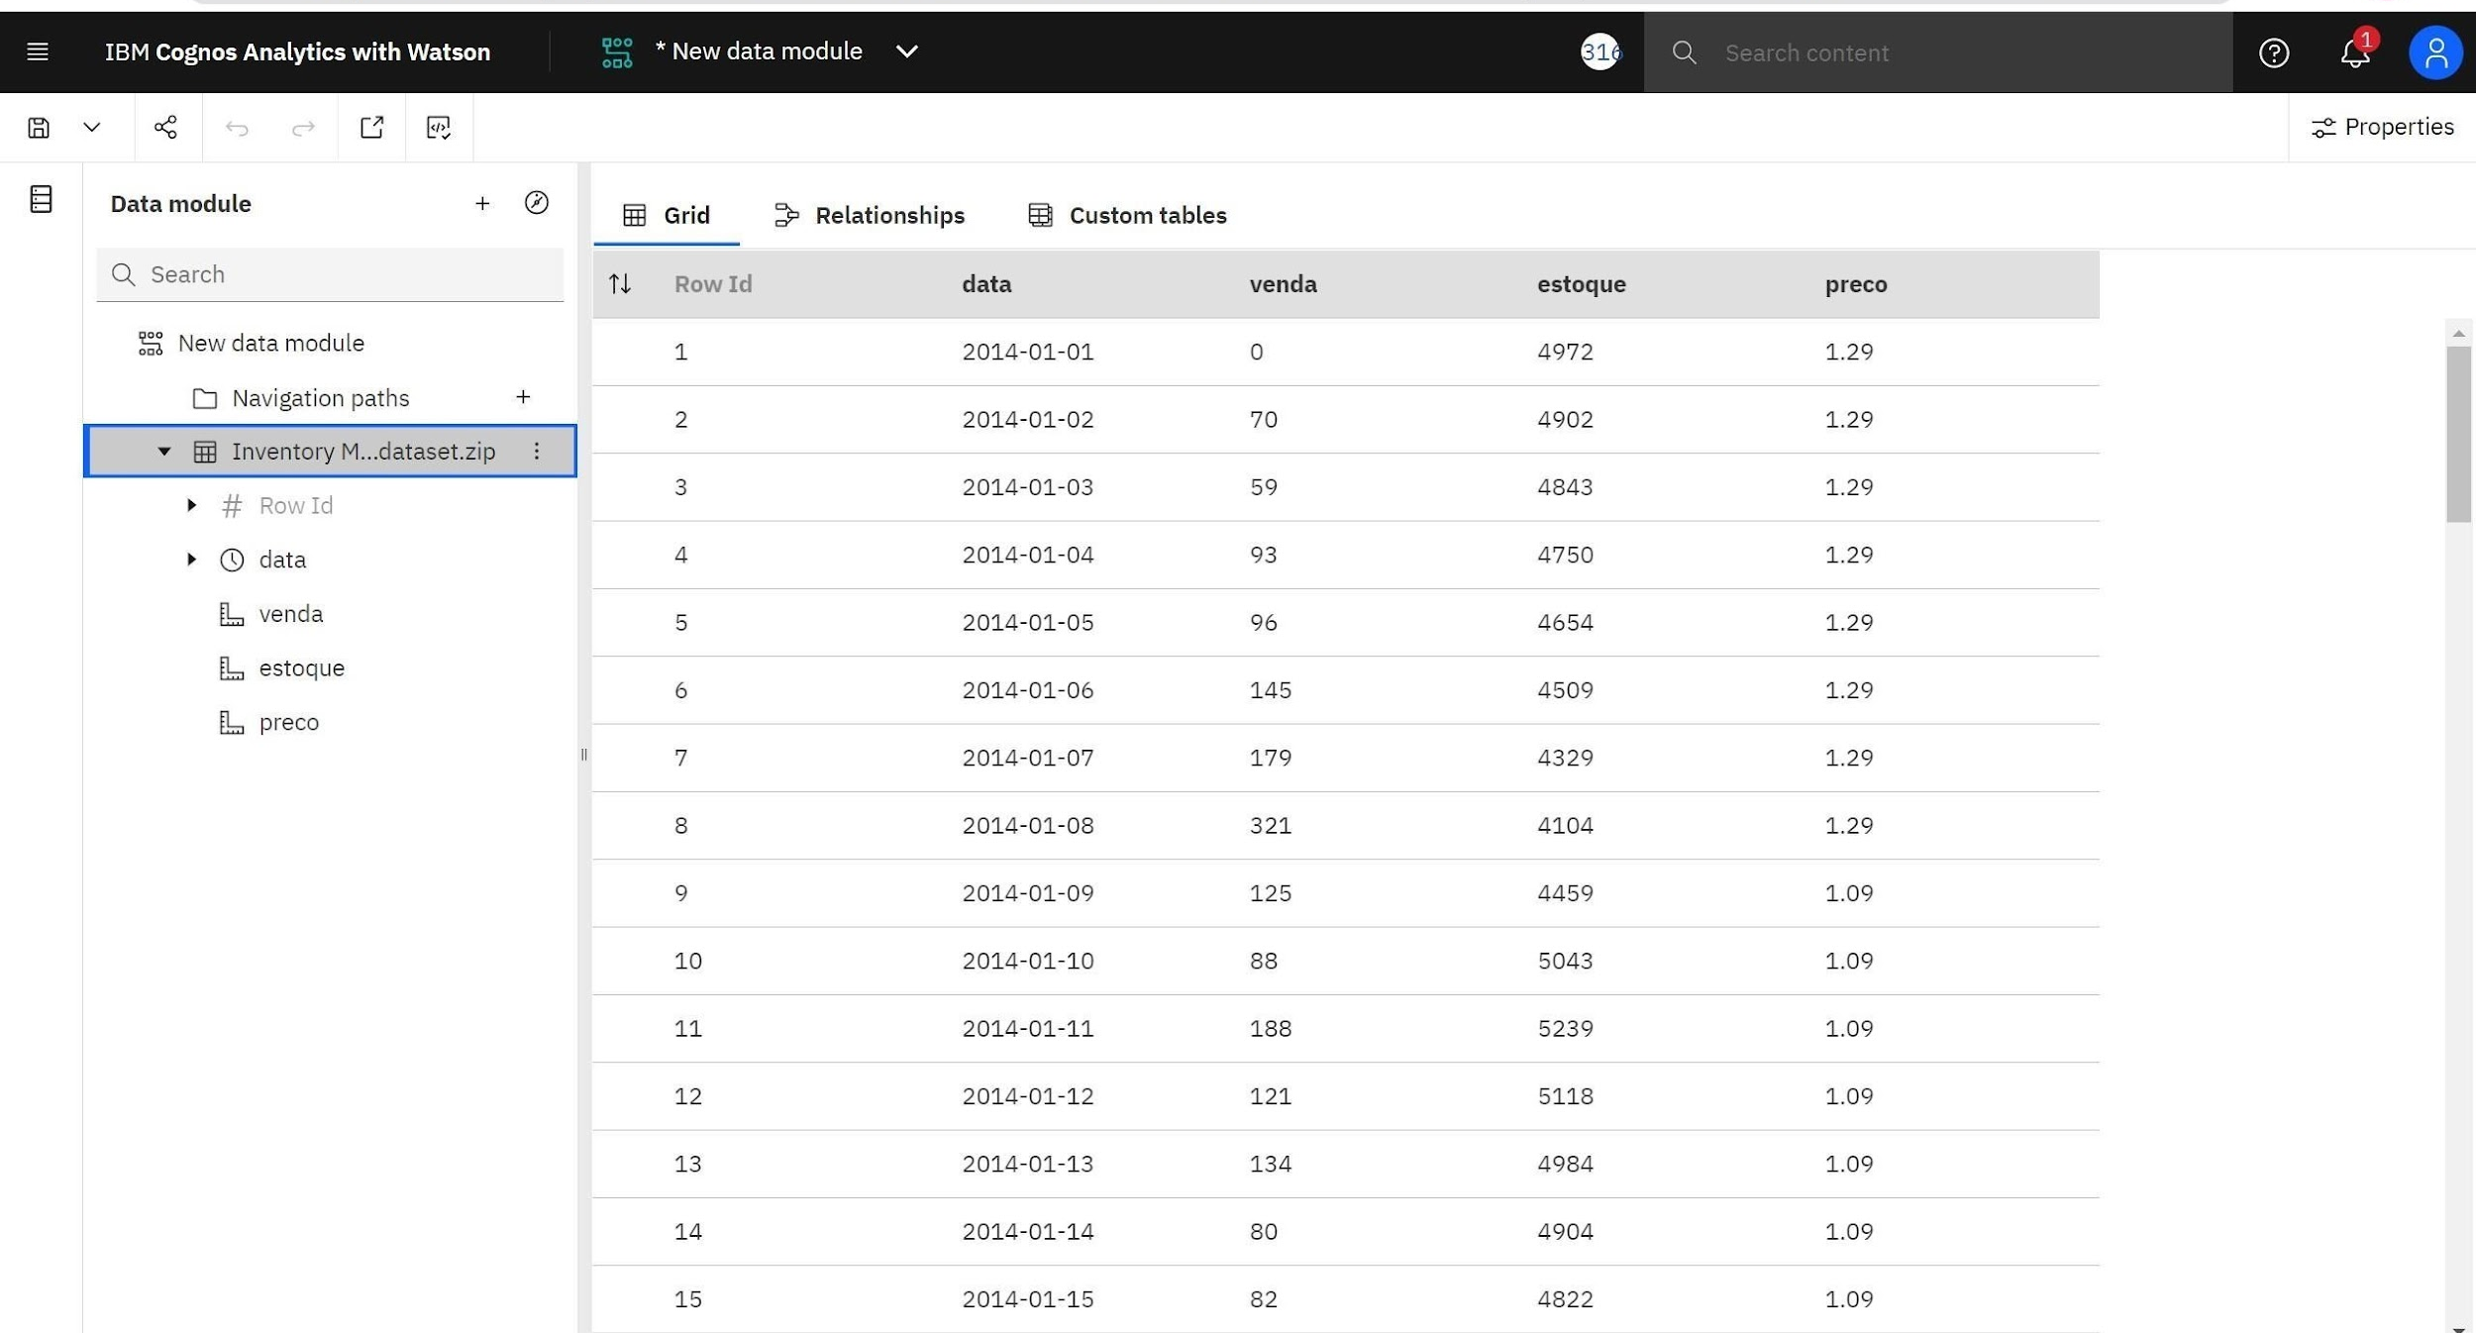

Slide 7
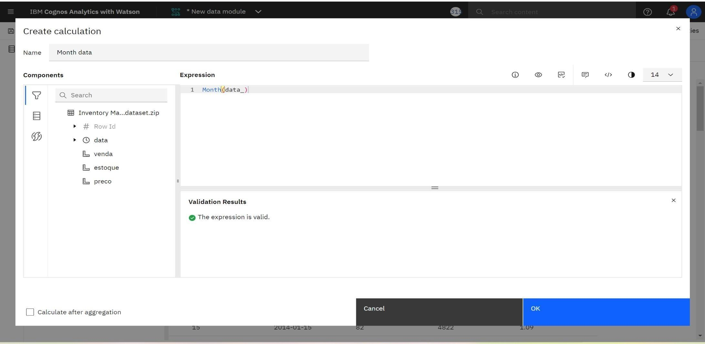
PREPARING THE DATASET :

Slide 8
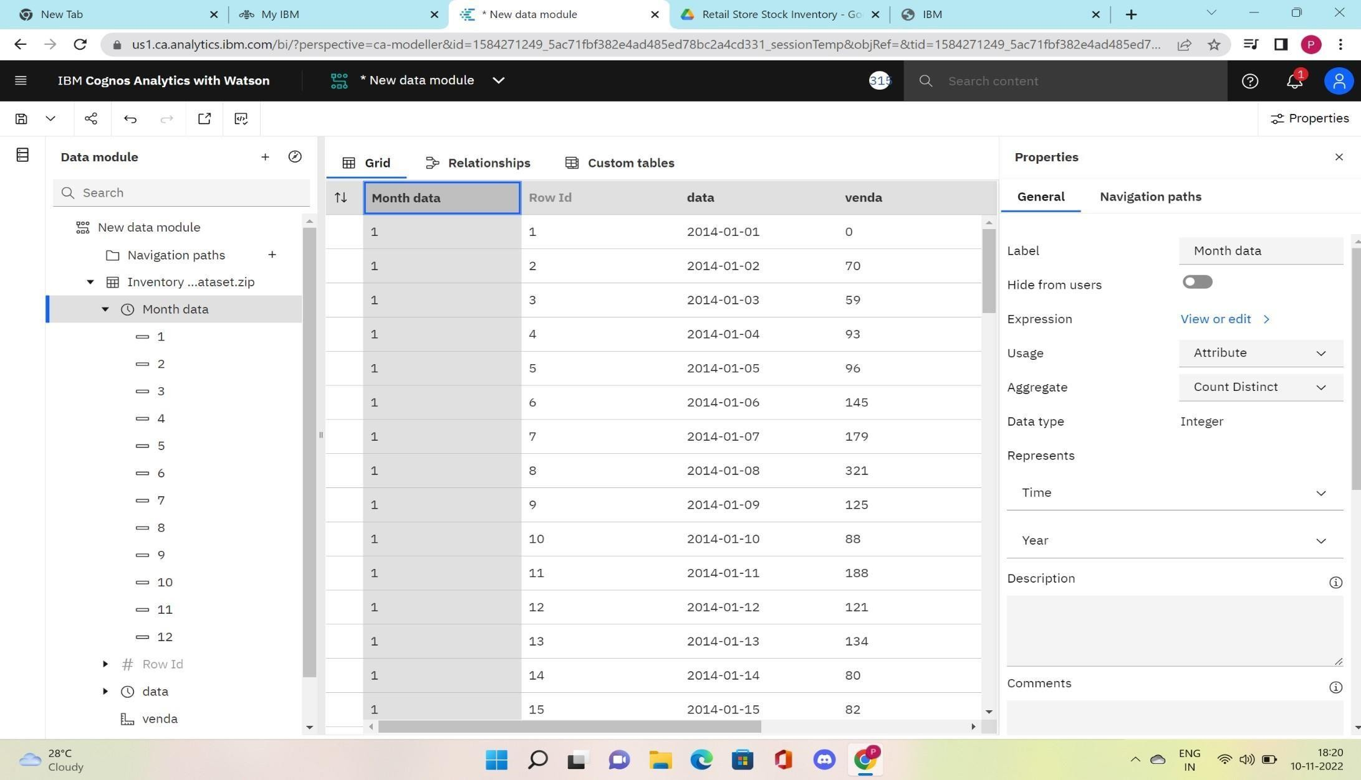

Slide 9
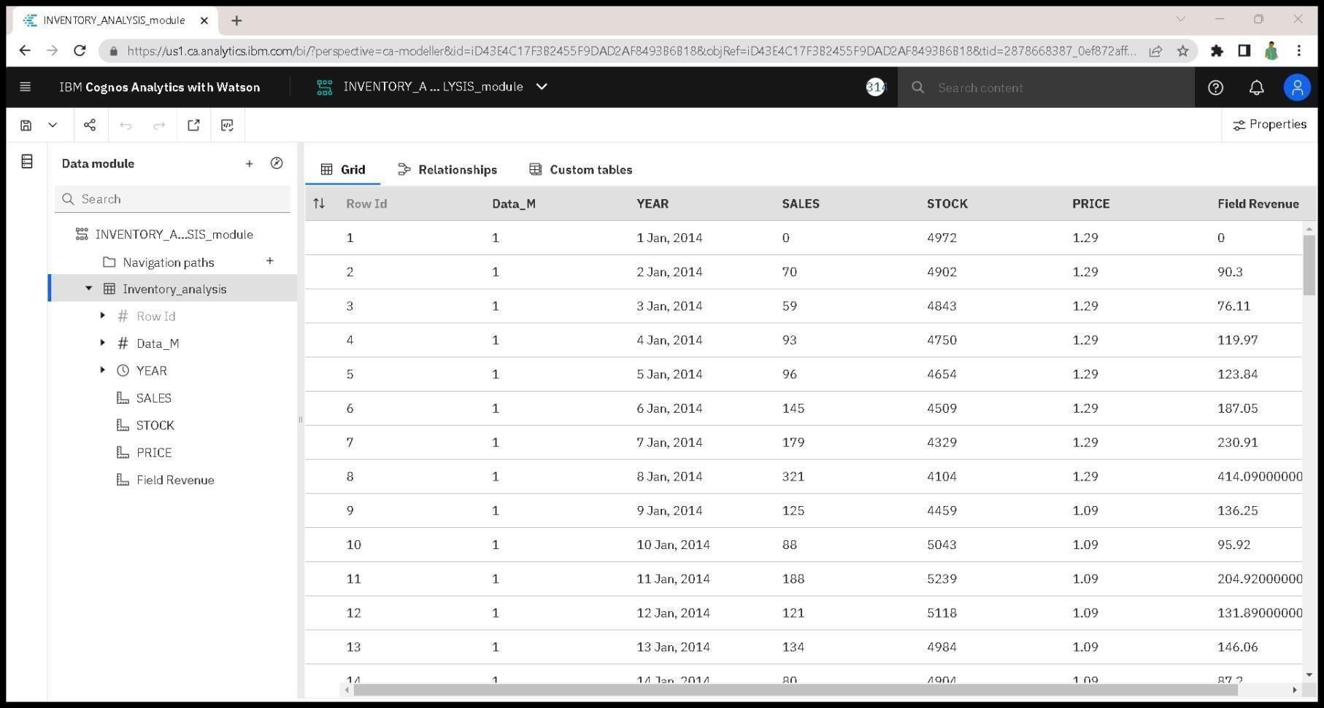
FINAL DATASET:

Slide 10
DATA EXPLORATION

Slide 11
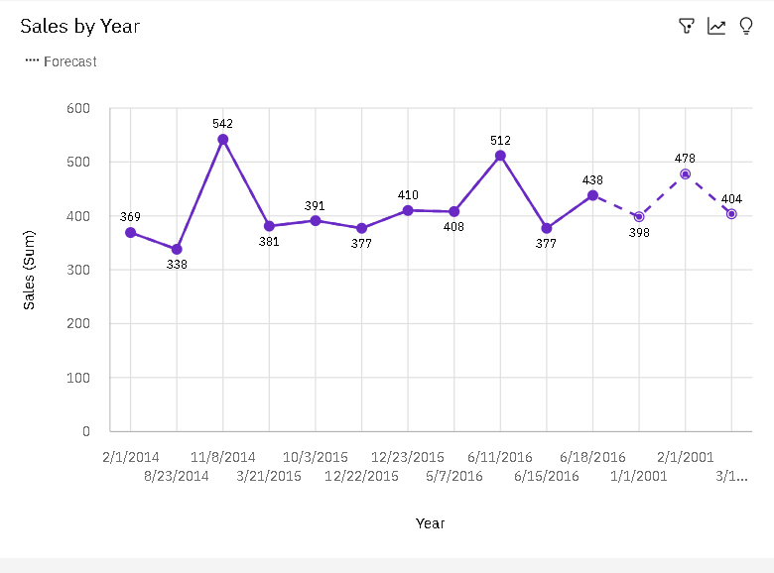

Slide 12
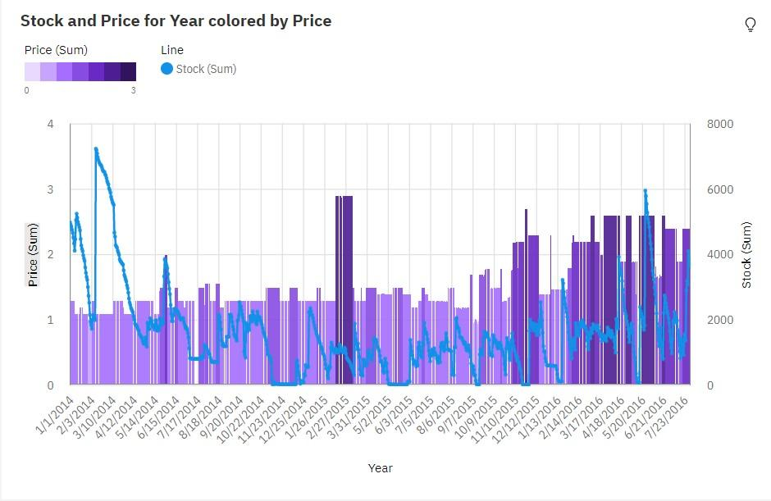

Slide 13
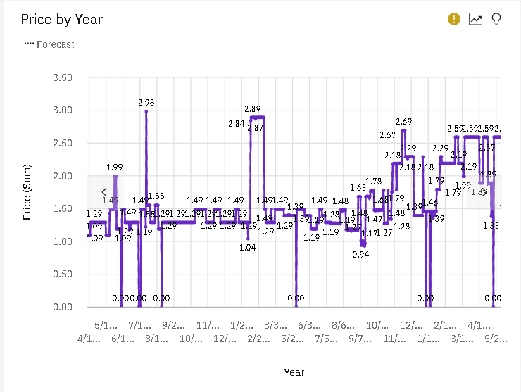

Slide 14
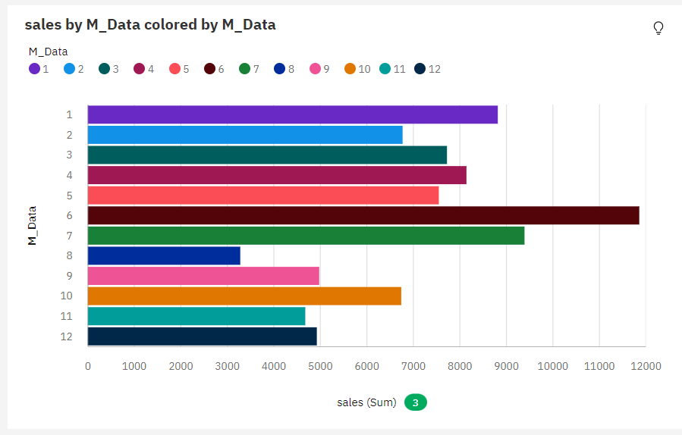

Slide 15
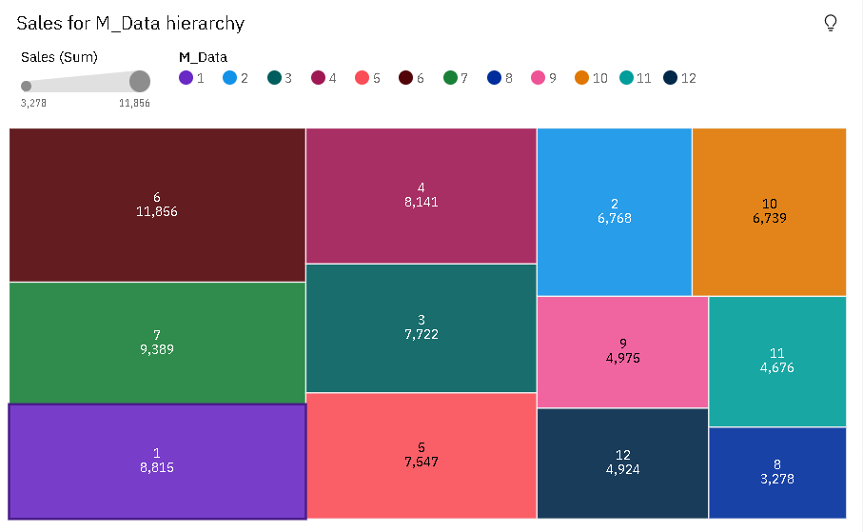

Slide 16
DASHBOARD CREATION

Slide 17
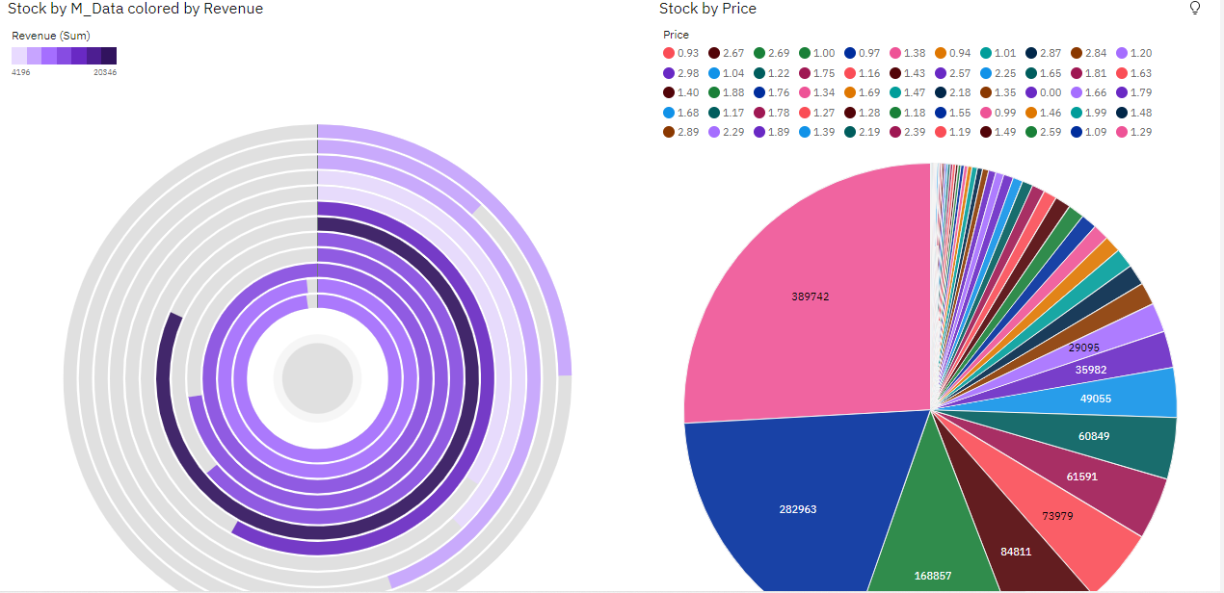

Slide 18
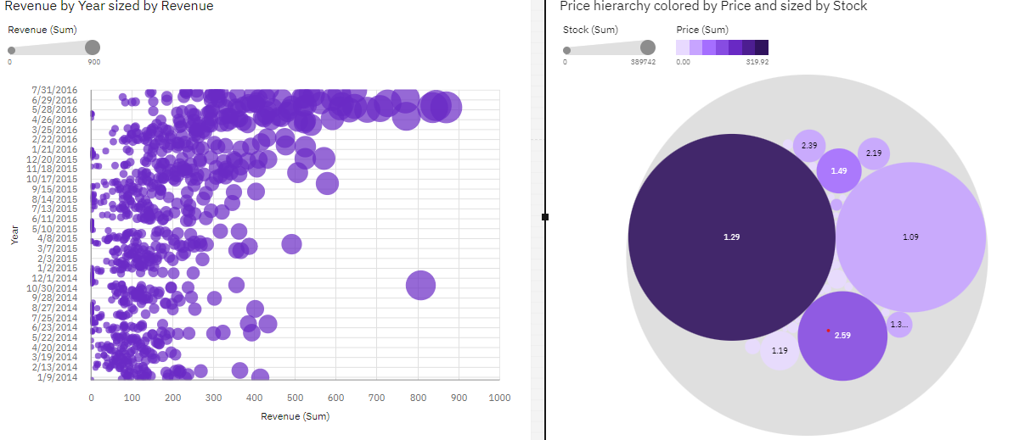

Slide 19
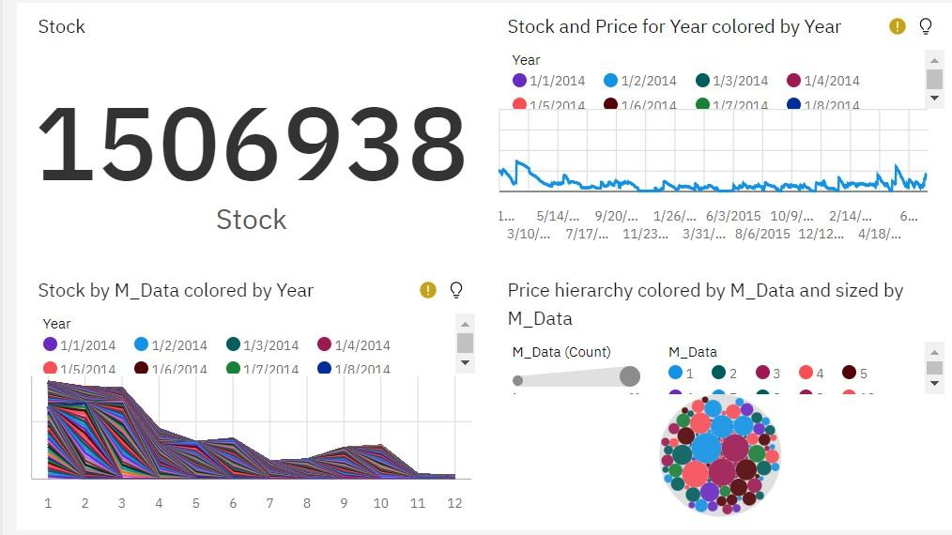

Slide 20
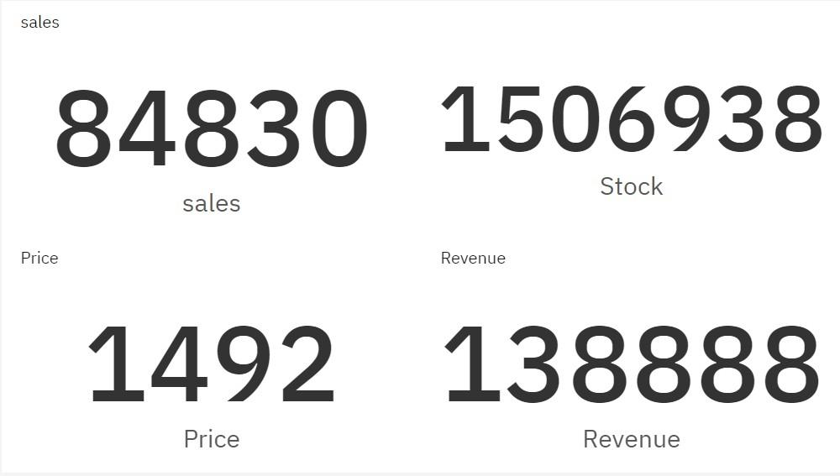

Slide 21
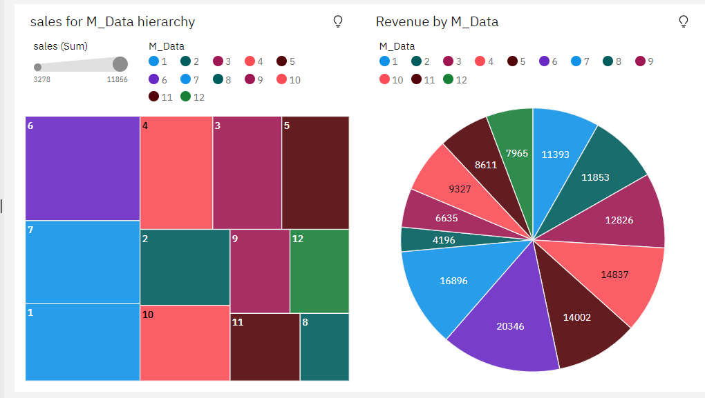

Slide 22
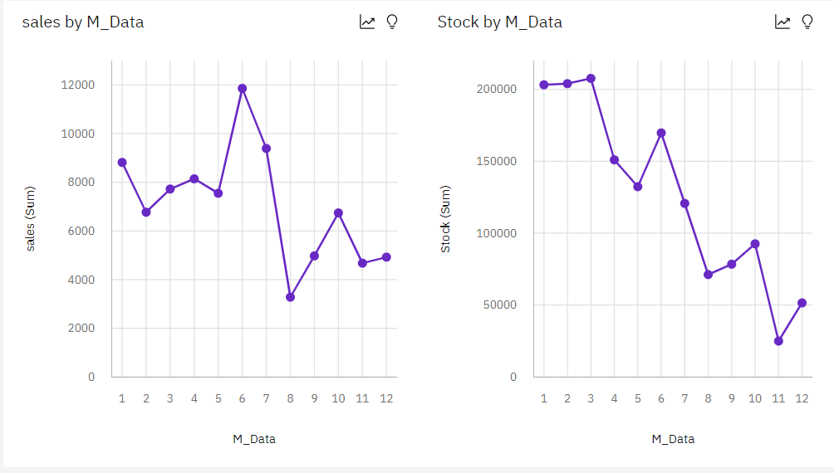

Slide 23
REPORT CREATION

Slide 24
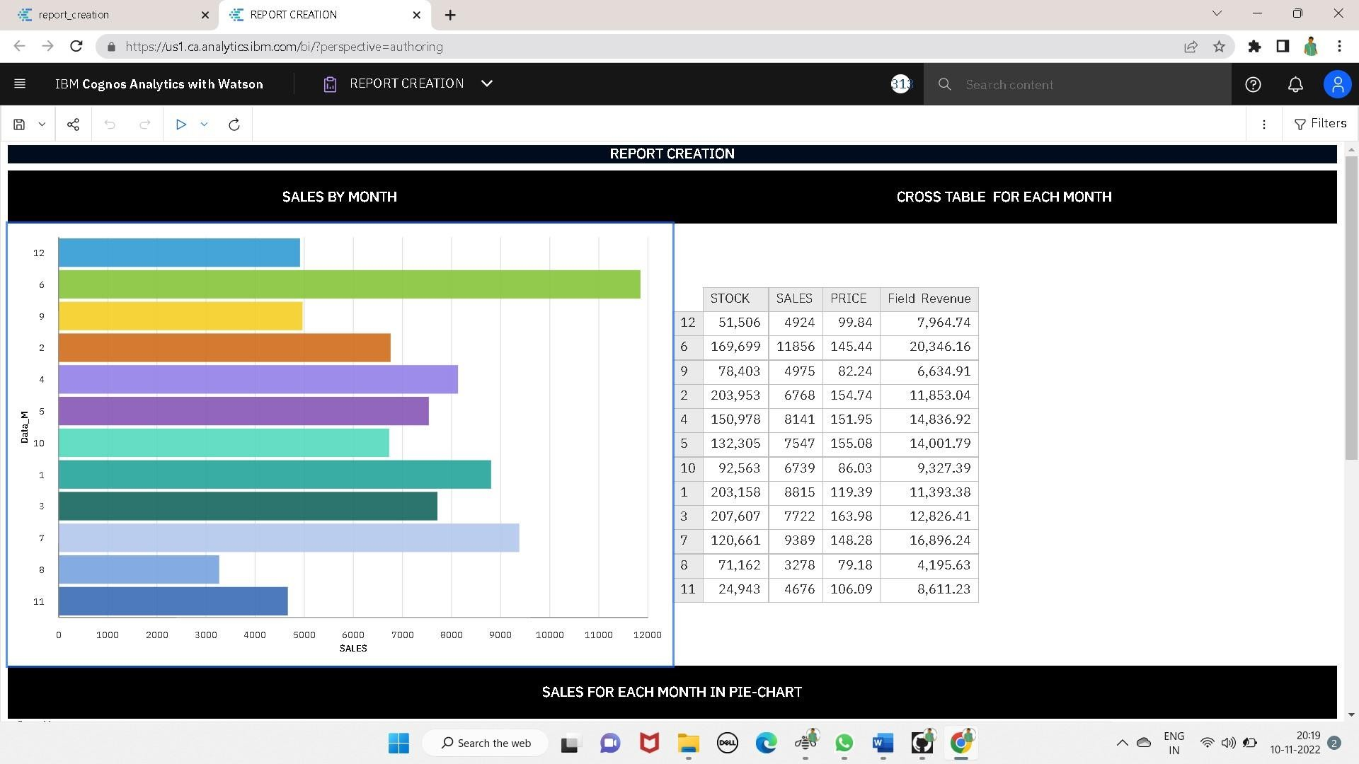

Slide 25
